Slide 1
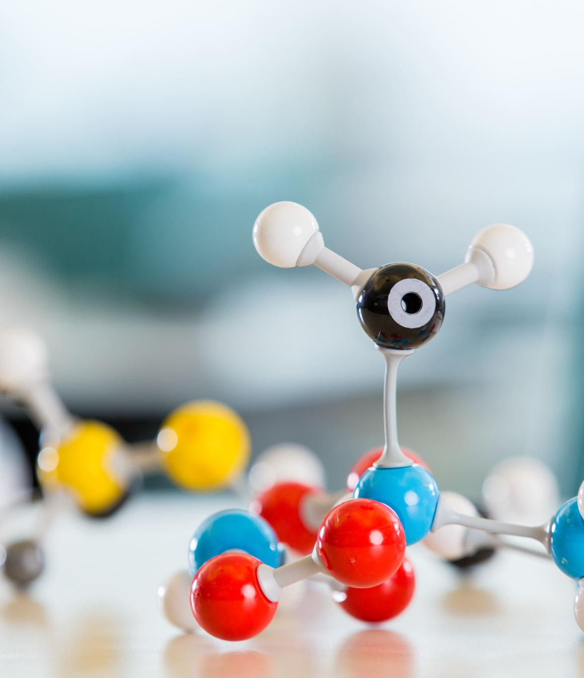
Molecular Imprinting
Bionanotechnology
BBL 747

Slide 2
Introduction
Molecular imprinting is defined as ‘‘the construction of ligand selective recognition sites in synthetic polymers
where a template (atom, ion, molecule, complex or a molecular, ionic or macromolecular assembly, including micro-organisms) is employed in order to facilitate recognition site formation during the covalent assembly of the bulk phase by a polymerization or polycondensation process,
with subsequent removal of some or all of the template being necessary for recognition to occur in the spaces vacated by the templating species.’’
The first MI-based synthetic receptors reported by Wulff in 1972
Compared to other recognition systems, MIPs, which possess three major unique features of structure predictability, recognition specificity and application universality.
Application in many fields, such as purification and separation, chemo/biosensing, artificial antibodies, drug delivery, and catalysis and degradation, owing to their high physical stability, straightforward preparation, remarkable robustness and low cost

Slide 3
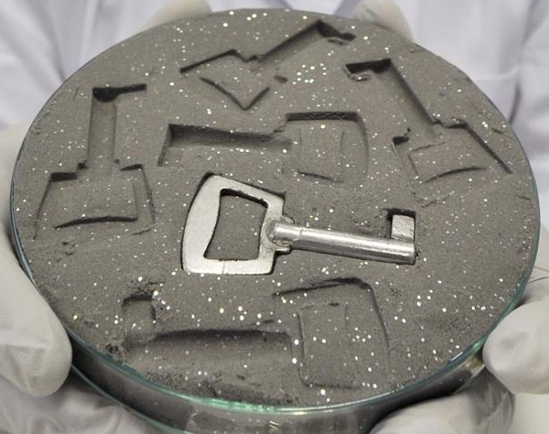
Surface Molecular Imprinting to Develop Biorecognition Elements
Classical approach: incorporate template and monomers all together
Difficulty in removing template
Rapid binding kinetics
Traces of template being easily removed
More flexible incorporation of multifunctionality
High surface-to-volume ratio, High level of specific binding sites
Better control of manufacturing process
“Lock-key”
Molecular lock
Adv. Mater. 2019, 1806328; Chem. Soc. Rev., 2016, 45, 2137--2211
http://nice.asu.edu/nano/molecular-imprinted-polymers-mip

Slide 4
Schematic representation for the synthesis of molecularly imprinted magnetic nanoparticles for S-Naproxen and the selective binding with the template (Goyal et al ACS Applied Nanomaterials 2019) (3-Mercaptopropyl)trimethoxysilane (MPS)

Slide 5
Fundamentals of MIPs
The process of molecular imprinting involves:
the polymerization of a functional monomer and
a cross-linker around a molecular template.
Firstly, template–monomer complexes are achieved between a template molecule and a complementary functional monomer, the exact constellation of which distinguishes the different types of molecular imprinting technologies from each other
A crosslinking polymerization reaction is then performed around the complex.
After the template molecule is extracted, the imprinted sites contain a three-dimensional network presenting pores with the geometry and position of the functional groups complementary to those of the templates
Two main methods to produce MIPs, i.e., based on covalent and noncovalent interactions between the template and the functional monomer.
Covalent imprinting, being stoichiometric, ensures that functional monomer residues exist only in the imprinted cavities.

Slide 6
Fundamentals of MIPs
Covalent imprinting often uses readily reversible condensation reactions involving boronate esters, ketals/acetals, and Schiff’s base.
However, covalent imprinting is regarded as a less flexible method since the reversible condensation reactions are limited.
To reach thermodynamic equilibrium is very difficult since the strong covalent interactions result in slow binding and dissociation.
Noncovalent imprinting can proceed by ionic interactions, hydrogen bonding, van der Waals forces and π–π interactions.
Most common, the dominant interaction is hydrogen bonding

Slide 7
Fundamentals of MIPs
Recently, noncovalent imprinting has become the most popular and general synthesis strategy due to the simplicity of operation and rapidity of binding and removal.
However, noncovalent imprinting is sensitive to even slight disruption of the interactions holding the complex together (for example, the presence of water), and it is therefore not very robust.
In order to combine the durability of covalent imprinting and the rapid target uptake of noncovalent imprinting, a new method called semi-covalent imprinting has emerged.
This method offers an intermediate alternative in which the template is bound covalently to the functional monomer, but template rebinding is based on noncovalent interactions.

Slide 8
Fig. Five main types of molecular imprinting: (i) noncovalent, (ii) electrostatic/ionic, (iii) covalent, (iv) semi-covalent, and (v) metal centre coordination.
An imprint molecule is combined with an appropriately chosen functional monomer, through noncovalent, covalent, or ligand (L) to metal (M)
interactions with complementary functional groups on the imprint. A complex of the imprint and functional monomer (IC) is formed, in which the
functional monomer is bound to the imprint molecule (I) by hydrogen bonding or van der Waals interactions, (II) by electrostatic or ionic interactions
(the charges on the imprint and functional monomer may be reversed), (III) through a covalent bond, (IV) through a covalent bond with a spacer (orange),
or (V) by ligand–metal or metal–ligand coordination. The functional monomer contains a functional group, Y, which undergoes a cross-linking reaction
with an appropriate cross-linker. After polymerization of the complex with a cross-linker to form the solid polymer matrix (grey), the imprint functional
monomer interactions are intact. The imprint is removed through washing, cleavage of chemical bonds, or ligand exchange, and leaves behind an imprint
cavity with functional groups on the walls. Subsequent uptake of a target molecule is achieved by noncovalent interactions (in types i, ii and iv), the
formation of a covalent bond (in type iii), or by ligand exchange (in type v) with target molecules that fit into the cavity and possess the correct structure.
The matrix may also participate in target recognition and binding through non-specific surface interactions that result from surface features created
around the imprint molecule during cross-linking

Slide 9
Essential elements of molecular imprinting
A typical MIP synthesis protocol contains a template, a functional monomer, a cross-linker, a polymerization initiator and a solvent (porogen).
In order to prepare MIPs with superior properties, numerous attempts have been made, since polymerization reaction is affected by many factors, such as the type and amount of monomer, cross-linker, initiator and solvent and the temperature and time of polymerization reaction.
As we know, the ‘‘three-elements of molecular imprinting’’ include template molecules, functional monomers and cross-linkers, which should especially be investigated.

Slide 10
Target templates
The ultimate goal of molecular imprinting is to generate MIPs with affinity and specificity comparable to those of the biological receptors so that they can eventually replace such biological entities in real applications.
Generally, an ideal template molecule should satisfy three requirements:
it should contain functional groups that do not prevent polymerization;
it should exhibit excellent chemical stability during the polymerization reaction
it should contain functional groups that can form complexes with functional monomers.

Slide 11
Functional monomers
The role of the functional monomer is to form a pre-polymerization complex with the template by providing functional groups.
So it is important to select a suitable functional monomer that can strongly interact with the template and form specific donor–receptor or antibody–antigen complexes prior to polymerization.
Generally, a functional monomer is comprised of two types of units- one is the recognition unit and the other is the polymerizable unit
MAA has been used as a ‘‘universal’’ functional monomer due to its hydrogen bond donor and acceptor characteristics.
Dimerization of MAA modestly enhanced the imprinting effect
high molar fractions of MAA would result in the large pore size of polymeric materials and further enhance the binding capacity of the polymers.

Slide 12
Fig. Illustration comparing imprinted (a and b) and nonimprinted polymers (c and d) formed from functional monomers that have or lack the ability to dimerize.

